Slide 1

CSC346-Computer Organization and assembly language Lab Lecture Semester-# Spring 2021
Prepared by:
Huma Chaudhry
M.Phil Computer Science

Slide 2
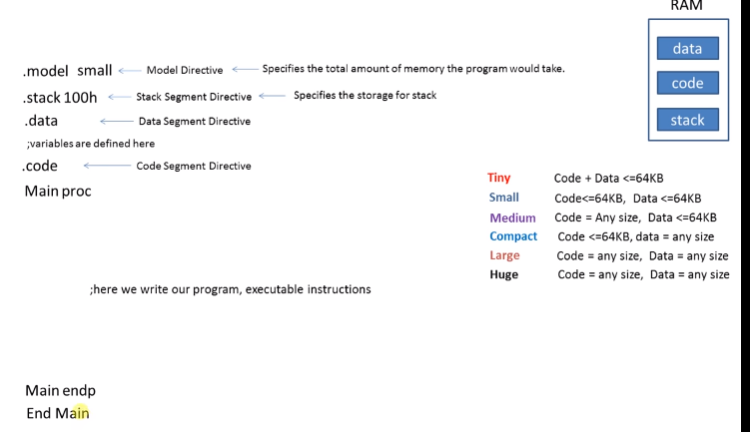
Assembly language syntax

Slide 3
Variable definition, initialization
. Data
syntax
Variablename datasize value
Value is initializer is value
Initializer directive is datasize
Variable name shouldn’t be the reserved words

Slide 4
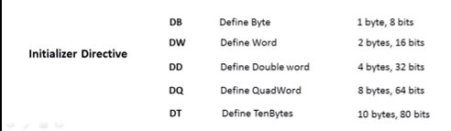

Slide 5
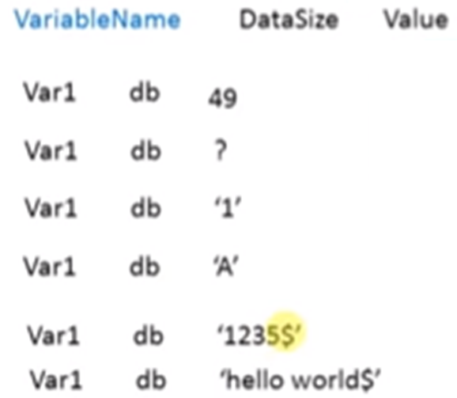
Format to initialize the variable
Asci code of the value
Syntax if you want to initialize the value in the code
Syntax to initialize the value to the variable
Syntax to initialize the alphabet to the variable
Syntax to initialize the number string
Syntax to initialize the string

Slide 6
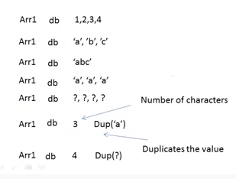
Format to initialize the array

Slide 7
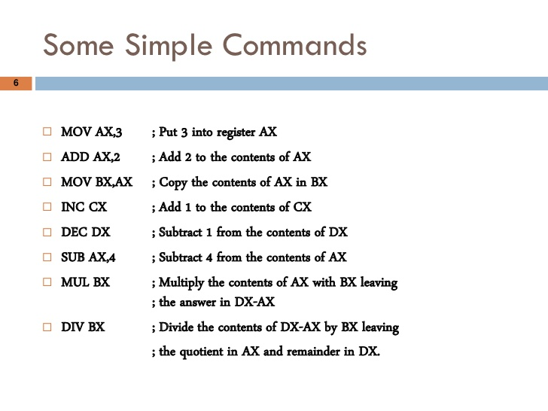

Slide 8
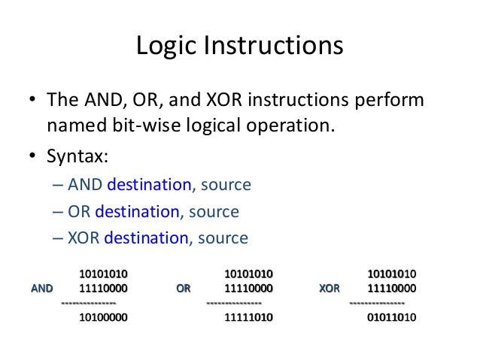

Slide 9
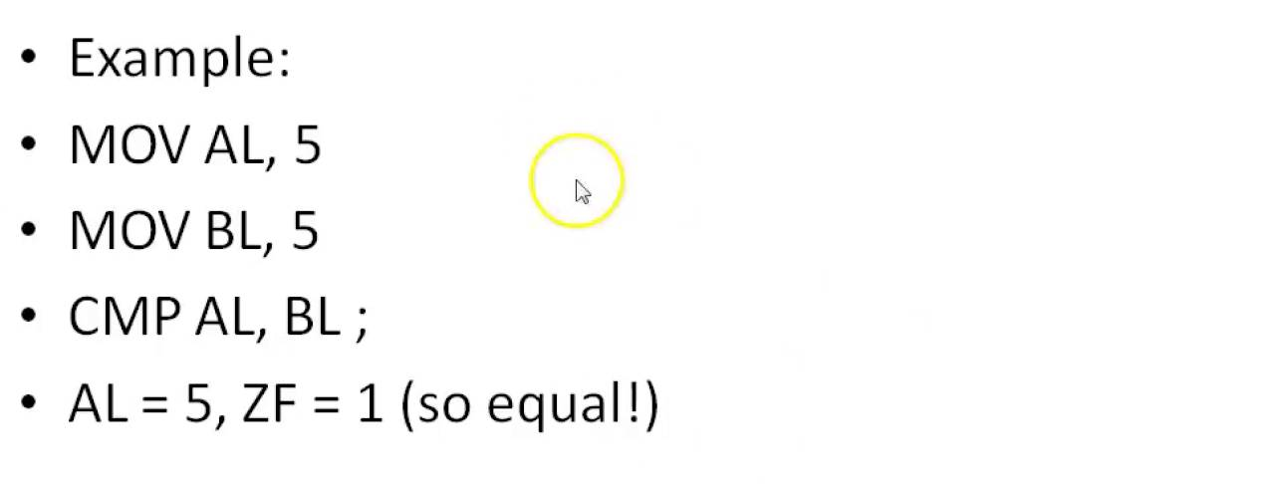
Compare Command

Slide 10
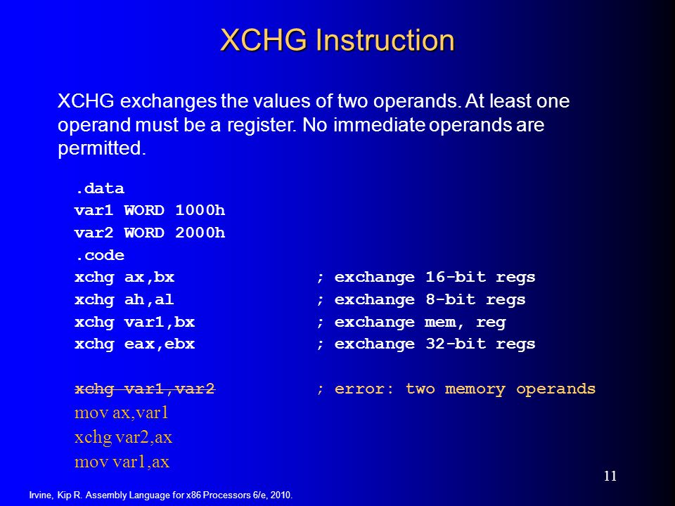

Slide 11
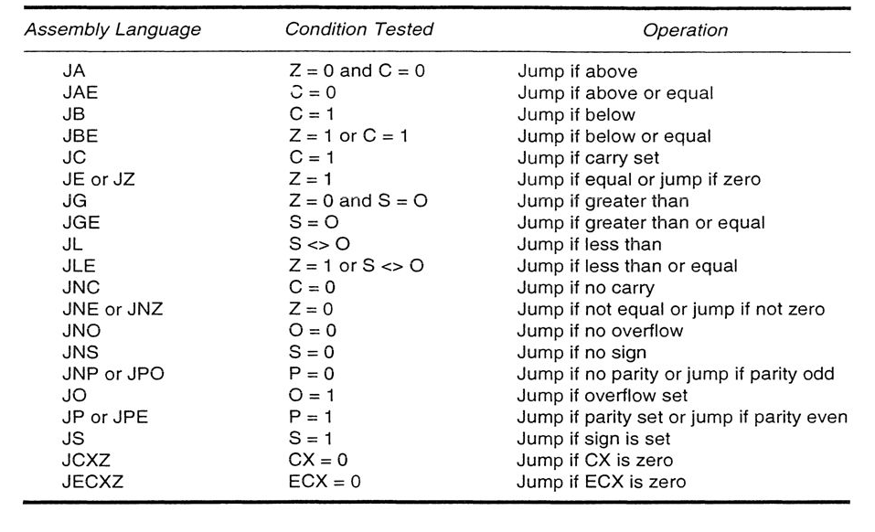
Conditional Jumps

Slide 12
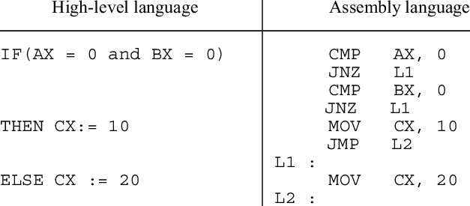

Slide 13
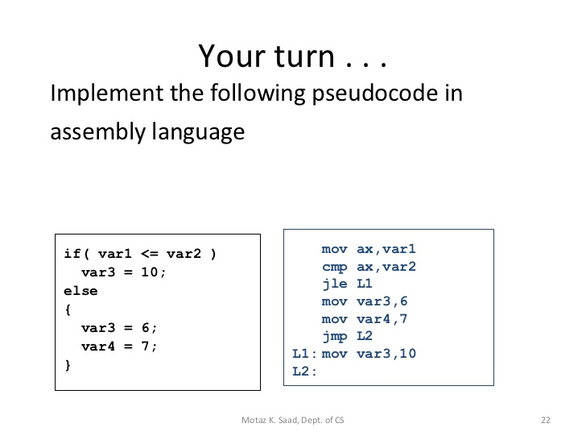

Slide 14
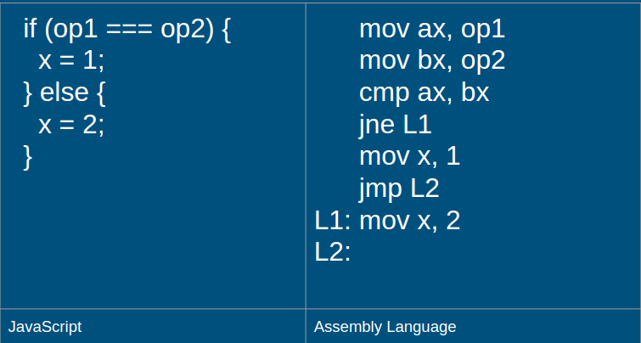
Take op1 and op2 input from the user

Slide 15
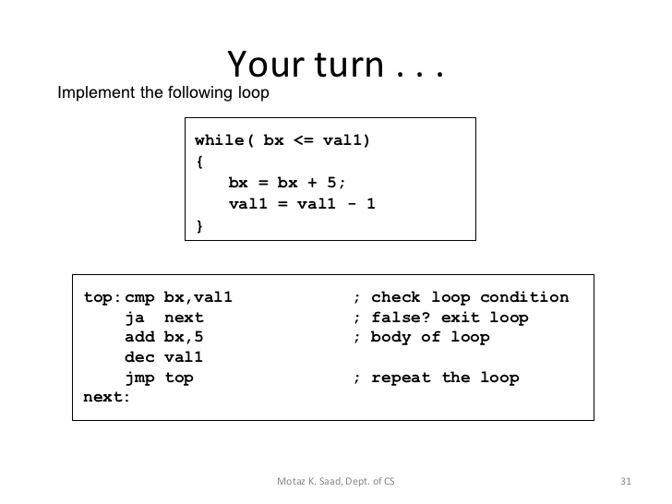

Slide 16
Q & A

